Slide 1
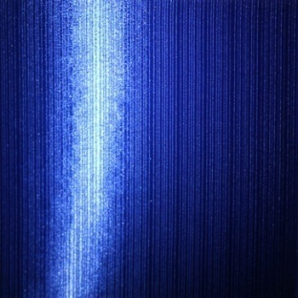
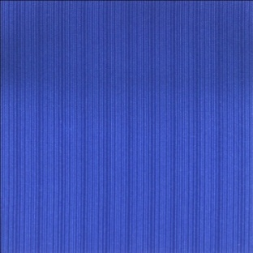

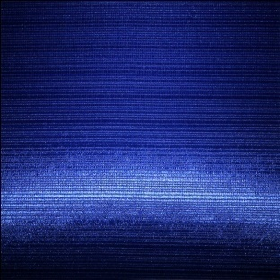

Image-Pair-Based Anisotropic Material Modeling
Jie Feng, Wangyu Xiao and Bingfeng Zhou
Peking University

Slide 2
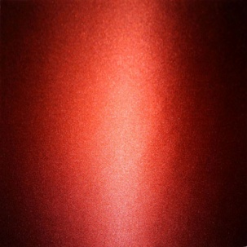
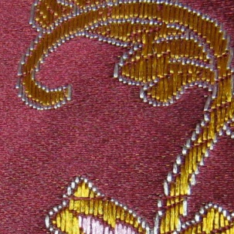
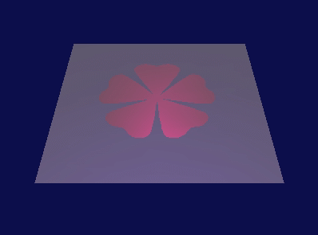
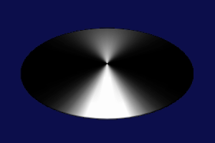
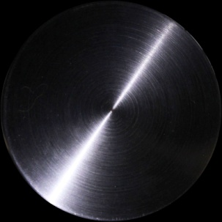
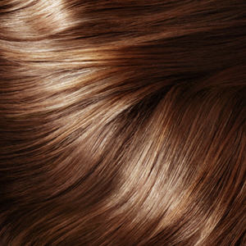
Motivation
Anisotropic material
Silk, satin, hair, brushed steel, ……
Varying surface appearance with different lighting conditions
More difficult in modeling and rendering
Notes:
Surface appearance of an object is important in this physical world.
Anisotropic materials (such as silk, hair, and steel) are a special category of surface material, because they have varying appearance in different lighting and viewing directions.
Hence, they are more difficult in modeling and rendering.

Slide 3
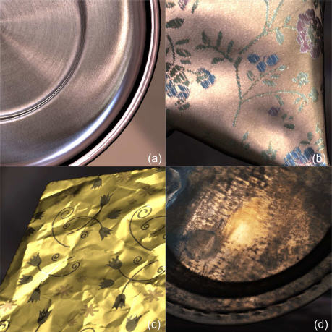
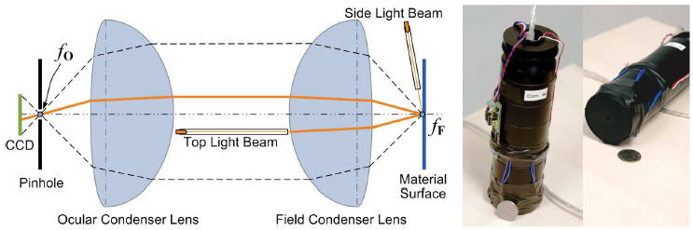
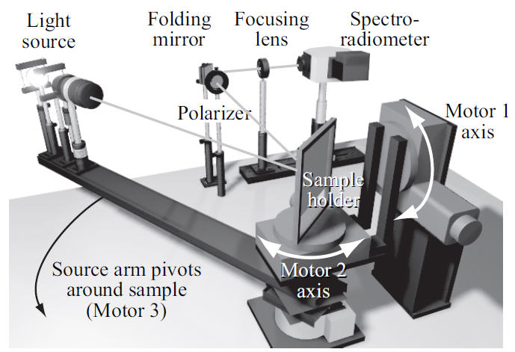
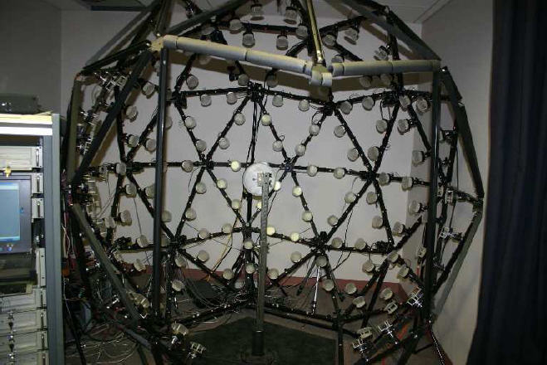
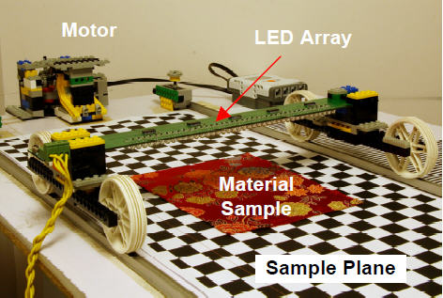
Motivation
Problems of existing methods
Large dataset
Dozens or hundreds of input images
Complex equipment
Specialized optical devices/lighting system
Time consuming
Data acquiring/Calculation
[Dong et al. 2010]
[Li et al. 2005]
[Gu et al. 2006]
[Wang et al. 2008]
Notes:
Some existing methods in literature can produce high-quality rendering results for anisotropic materials, but there are still many problems.
First, these methods usually require a large input dataset, some may need up to hundreds of input images.
And some of the methods even require specialized equipments, such as special cameras or lighting systems, which are too expensive and complex for ordinary users.
They also consume more time in data acquiring and calculations, and are hard to apply in practice.

Slide 4
Our Method
Fast anisotropic material modeling
Inexpensive, limited resource
Simple input
Texture image + Highlighted image
No expensive equipment
Ordinary camera / LED light
Reflectance & geometry properties
Diffuse color / Orientation field / BRDF parameters / Height field
Rendered output
New viewing and lighting conditions
Texture Image
Highlighted Image
Rendered Image
Ground truth
Notes:
In this paper, we aim to propose a fast anisotropic material modeling method, which should be inexpensive, using limited resources, and easy to implement.
Our input data is very simple – only one texture image and one hightlighted image.
The images are taken with an ordinary camera and a LED light, no expensive equipment required.
From the image pair, we can recover necessary reflectance & geometry properties of the material sample, and produce synthesized rendering images in new viewing and lighting condithions.

Slide 5
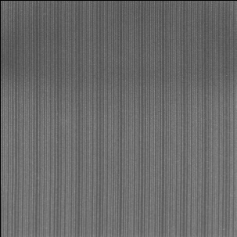
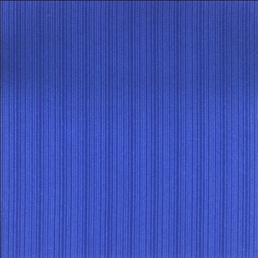



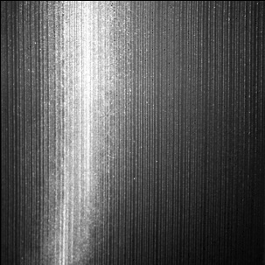
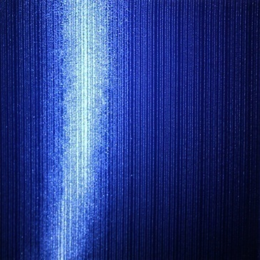
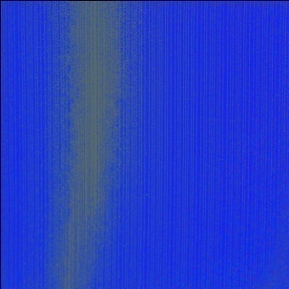
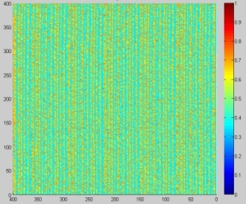
Overview
Illumination
Texture Image
Orientation Field
Reflectance
Input Image Pair
BRDF parameters
Rendered Image
Illumination
Highlighted Image
Reflectance
Height Field
Notes:
Here is an overview of our workflow:
First, we acquire the input image pair.
And then, the images are decomposed into intrinsic images, respectively.
From the intrinsic images, we step by step calculate:
-- An orientation field (that indicate the anisotropic orientations of the material)
-- A group of BRDF parameters (that describe the reflectance property of the material)
-- A height field (to recover the texture details)
Finally, using these information, new images of the material under arbitrary lighting & viewing directions can be rendered.
(*Blue arrows indicate the processes of modeling; Red arrows indicate the process of rendering.)

Slide 6
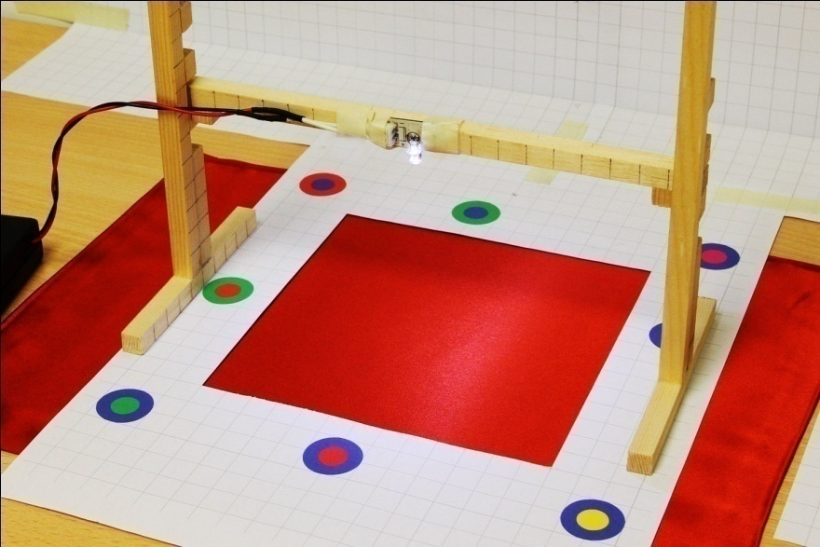
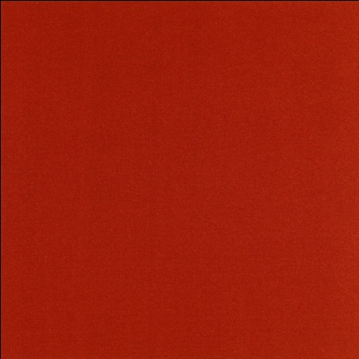
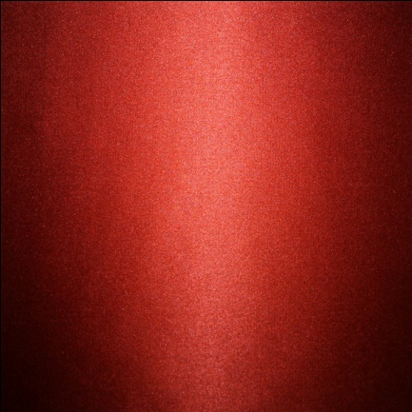
Image Acquiring
Material sample
Nearly planar
Camera
Ordinary digital camera
Fixed position
Automatically calibrated
Texture image
Diffuse light
Highlighted image
Single LED point light source (with known position)
LED light source
Material sample
Calibration target
Texture Image
Highlighted Image
Notes:
The acquiring of the input image pair is very simple. Here is the setup.
Currently we focus on nearly planar material samples, such as a piece of silk.
The images are taken by an ordinary digital camera. It is fixed on a tripod and automatically calibrated with these targets.
The texture image is simply captured in a diffuse light.
And the highlighted image is taken in a single LED point light source.

Slide 7
Intrinsic Image Decomposition

Slide 8
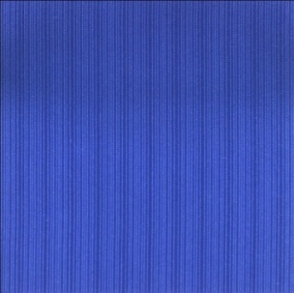
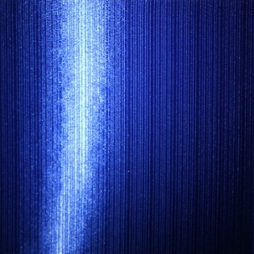

Intrinsic Image Decomposition
Decompose the input images into intrinsic images
Illumination Image (lighting information at each pixel)
Reflectance Image (diffuse color of the material)
To avoid the effect of irrelevant component of the input image
Illumination
Illumination
Texture Image
Highlighted Image
Reflectance
Reflectance
Notes:
Before used in modeling, the input images are decomposed into intrinsic images.
That is: an illumination image and a reflectance image.
We are doing this in order to avoid the effect of irrelevant component of the image.
In fact, these two components (illumination of texture, reflectance of highlight) are not used in further computation.
Only these two images are used. The reflectance component of the texture image contains diffuse color of the material, and the illumination component of the highlighted images is used to recover the BRDF parameters.

Slide 9



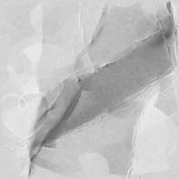


Intrinsic Image Decomposition
Utilizing a Retinex-based method [Shen et al. 2008]
The reflectance is an intrinsic property of the material
Not affected by the non-uniform illumination/shading
Recovering image reflectance
Pixel color
Reflectance
Normalizing
Shading
Solving reflectance intensity r_{i,j}
Intensity-normalized reflectance (chromaticity)
Notes:
Here we adopt a retinex-based method to perform the decomposition.
The main idea of the method is that:
The reflectance is an intrinsic property of the material, and it is not affected by the non-uniform illumination(shading).
Therefore, chromaticity differences are only caused by reflectance changes.
And the image decomposition problem can be turned into a problem of recovering image reflectance.
Given the color of the pixel (i,j), it is a product of the reflectance and the shading.
If we normalize the intensity of the image, we get an intensity-normalized reflectance image R^, that is in fact the chromaticity map of the image.
Then we will solve an optimizing problem to calculate the reflectance intensity r_ij
=====================================
Retinex（视网膜”Retina”和大脑皮层”Cortex”的缩写）理论是一种建立在科学实验和科学分析基础上的基于人类视觉系统（Human Visual System）的图像增强理论。该算法的基本原理模型最早是由Edwin Land（埃德温•兰德）于1971年提出的一种被称为的色彩的理论，并在颜色恒常性的基础上提出的一种基于理论的图像增强方法。Retinex 理论的基本内容是物体的颜色是由物体对长波（红）、中波（绿）和短波（蓝）光线的反射能力决定的，而不是由反射光强度的绝对值决定的；物体的色彩不受光照非均性的影响，具有一致性，即Retinex 理论是以色感一致性（颜色恒常性）为基础的。 不同于传统的图像增强算法，如线性、非线性变换、图像锐化等只能增强图像的某一类特征，如压缩图像的动态范围，或增强图像的边缘等，Retinex可以在动态范围压缩、边缘增强和颜色恒常三方面达到平衡，因此可以对各种不同类型的图像进行自适应性地增强。正因为Retinex诸多良好的特性，使Retinex算法在很多方面得到了广泛的应用。
对于观察图像S中的每个点(x,y)，用公式可以表示为： S(x,y)=R(x,y)﹒L(x,y) （1） 据Retinex 理论，物体的颜色是由物体对光线的反射能力决定的，而物体对光线的反射能力是物体本身固有的属性，与光源强度的绝对值没有依赖关系。因此通过计算各个像素间的相对明暗关系，可以对图像中的每个像素点做校正，从而确定该像素点的颜色。
========================================
[Shen 2008]用图的亮度信息对每个像素在RGB空间的颜色值进行归一化，将每个像素邻域像素归一化后的颜色值组成一个向量，并利用马尔可夫随机场原理，假设两个像素如果具有相同的邻域向量，则这两个像素的反射值是相同的。通过这样的假设将图中的所有像素进行分组，每组中的像素在反射图中的亮度成分是相同的，从而将问题的规模大幅度减小。
与[shen 2008]类似，我们利用了基于颜色的Retinex方法，即相邻像素色度值变化大是由于反射属性的变化，而其它变化则是因光照的变化引起的。
特征向量的维度包括RGB，亮度值，邻域均值和方差（不包含x方向梯度和y方向梯度）。
我们的目标是将图像I分解成反射图R和光照图S的乘积，
将I归一化后为I尖，反射图R归一化为R尖，归一化也就是将像素的颜色除以亮度，并令R尖等于I尖，此时的反射图还缺少亮度成分，所以问题就转化为求反射图中的亮度成分r，使得反射图R=R尖乘上r

Slide 10
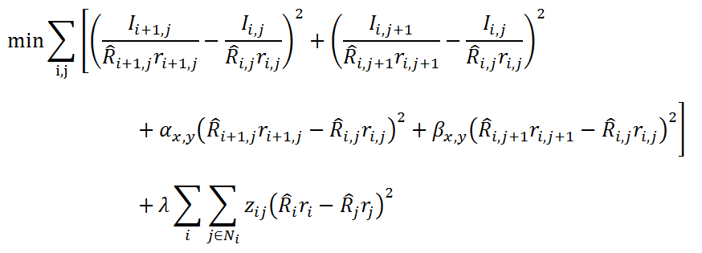
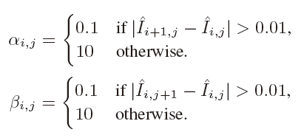

Intrinsic Image Decomposition
Solving reflectance intensity r_{i,j} by optimizing:
Penalize large illumination derivatives
Penalize large reflectance derivatives
similar feature vectors → similar reflectance
ρ: feature vector of each pixel
Pixel color
Average illuminance
Standard deviation of the luminance
Notes:
In this optimizing problem,
The first two terms: penalize large illumination derivatives
The third and the fourth: penalize large reflectance derivatives
The fifth term: ensures that pixels with similar feature vectors have similar reflectance
Here, α and β are coefficients, and z_ij is a function of the feature vector ρ.
The feature vector is defined in the neighborhood of each pixel, contains the pixel color, average illumination, and standard deviation of the luminance

Slide 11

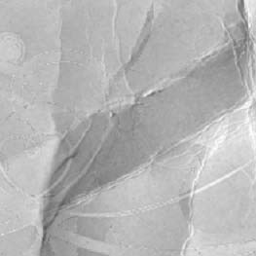
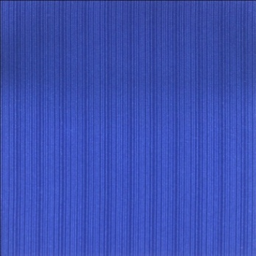
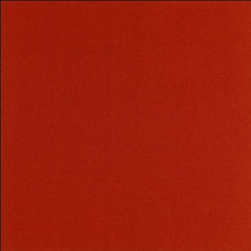
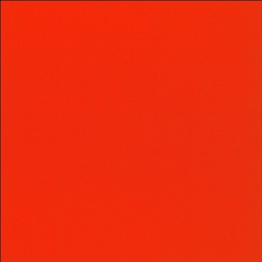
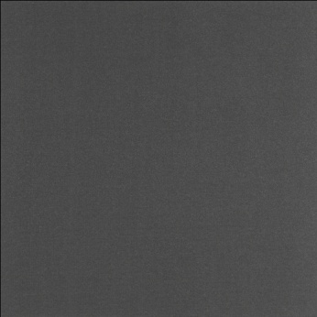
Intrinsic Image Decomposition
Reflectance
Illumination
Reflectance
Illumination
Input image
[Dong et al. 2008] (before interactive refinement)
Output of our method
Texture image
Reflectance
Illumination
Texture image
Reflectance
Illumination
Notes:
After solving the reflectance component, the illumination component can also be calculated.
Here are two examples of the results.
In the third example, we give a comparison with a prior work.
Notice that there are obvious shading in the reflection image (b) and white lines in the illumination image (c), while in our result these artifacts are removed.

Slide 12
Calculating Orientation Field

Slide 13
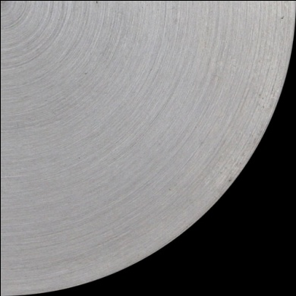
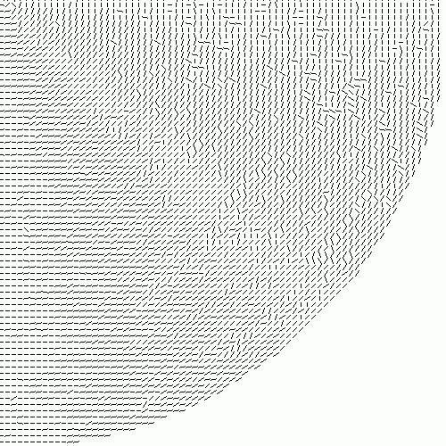
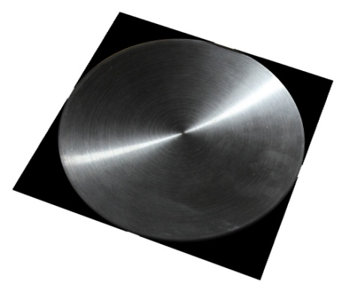
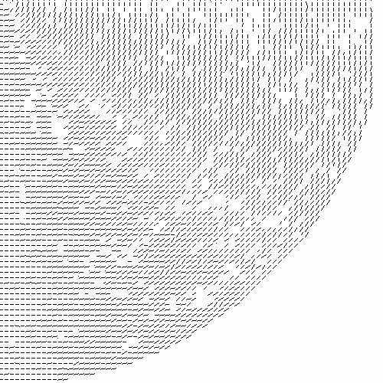
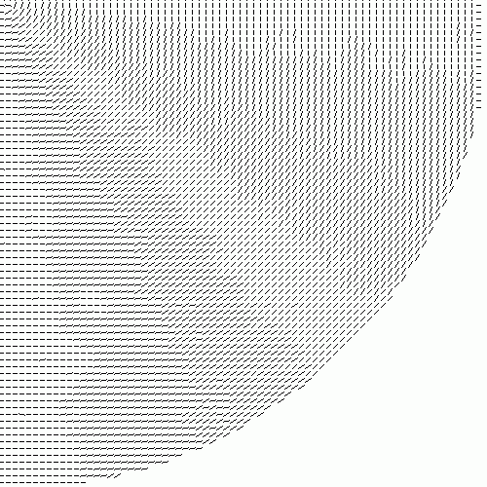
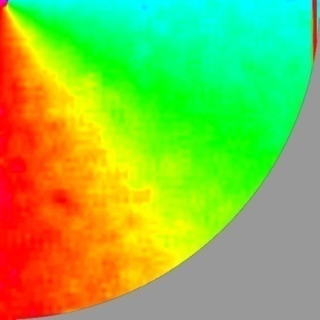
Calculating Orientation Field
Anisotropic orientation
Fine-line textures shown on anisotropic materials
Determined by the microstructures
Directly related to the anisotropic appearance
Extracting the orientation field
Prior works: multiple input images, varying light sources
Our method: use only one input texture image
Texture Image
Initial Orientation Field
Removing Noises
Optimized Orientation Field
Interpolated Orientation Field

Slide 14
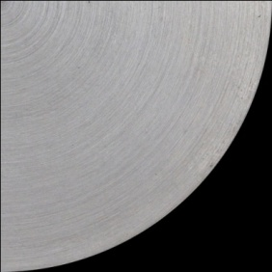




Calculating Orientation Field
Initializing
Image gradient (Sobel operators)
Dominant orientation angle of an s×t patch:
Optimization
Patch coherence for measuring fitting error
Discard patches with poor coherence
Recalculate according to the N valid neighbors
Interpolation
Smooth and continuous orientation field
Texture Image
Removing Noises
Optimized
Initialized
Interpolated

Slide 15
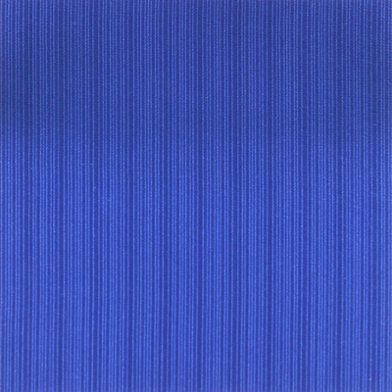

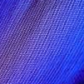

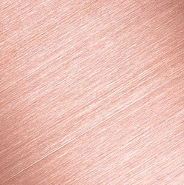
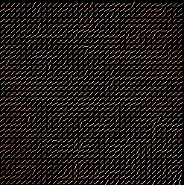
Calculating Orientation Field
Results

Slide 16
Estimating BRDF Parameters

Slide 17
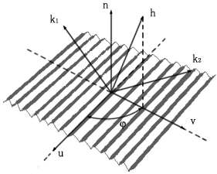

Estimating BRDF Parameters
Ashikhmin-Shirley BRDF model
Anisotropic parameter model
Microfacet distribution
Specular and diffuse component
Four parameters:
n_{u} and n_{v} — control the shape of the specular lobe
R_{d} and R_{s} — the diffuse / specular colors
[Ashikhmin and Shirley 2000]

Slide 18

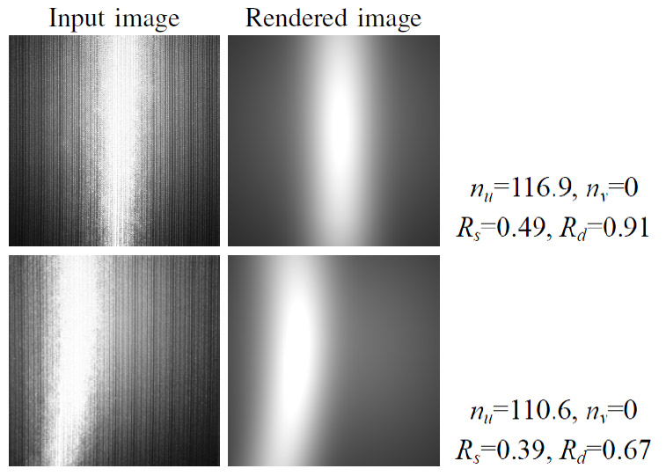
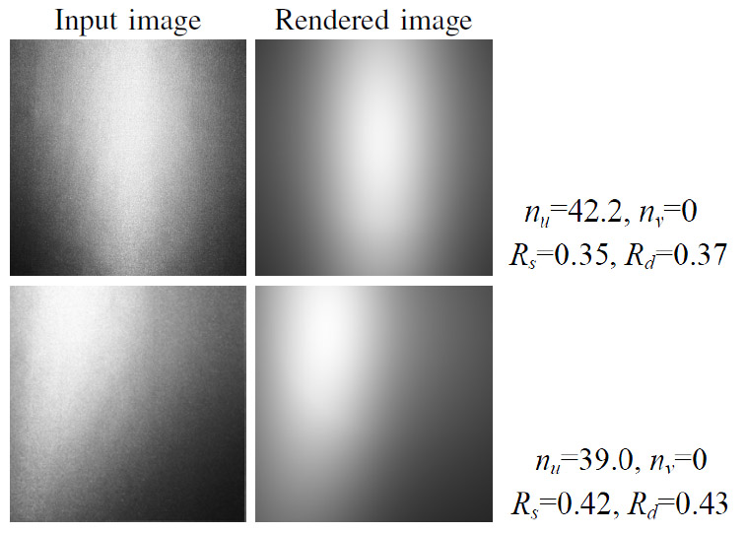
Estimating BRDF Parameters
Obtain BRDF parameters by optimizing:
I (R_{s}; R_{d}; n_{u}; n_{v}) — Rendered image
I₀ — Illumination component of the highlighted image
ssim(I; I₀ ) — Structural similarity of two images [Wang et al. 2004]
Results
Similar appearance in illumination
Lack of some texture details
Sample 2
Red Silk
Sample 1
Blue Silk

Slide 19
Computing Height Field

Slide 20

Computing Height Field
Estimate a height field to recover texture details
Feature vector ρ for each pixel
The luminance, the gradient along x and y direction
Similar feature vectors → similar height
Calculating height field H by optimizing:
I’ — illumination image
I(H) —the rendered image
N_{i} — the nearest pixels of pixel i

Slide 21



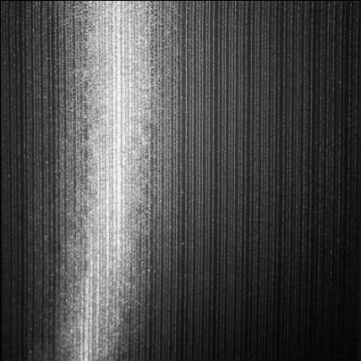
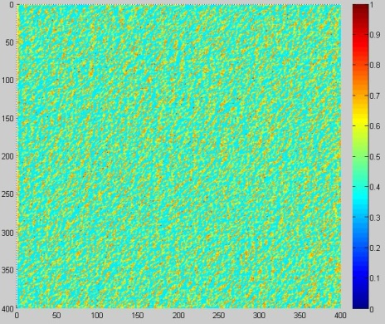

Computing Height Field
Input texture image
Calculated height field
Rendered without height field
Rendered with height field
Input illumination image

Slide 22
Rendering Results

Slide 23



New Image Synthesizing
Reflectance image
Orientation Field
Diffuse image
BRDF parameters
Diffuse component
Rendered image
A-S BRDF model
Specular component
Height Field

Slide 24
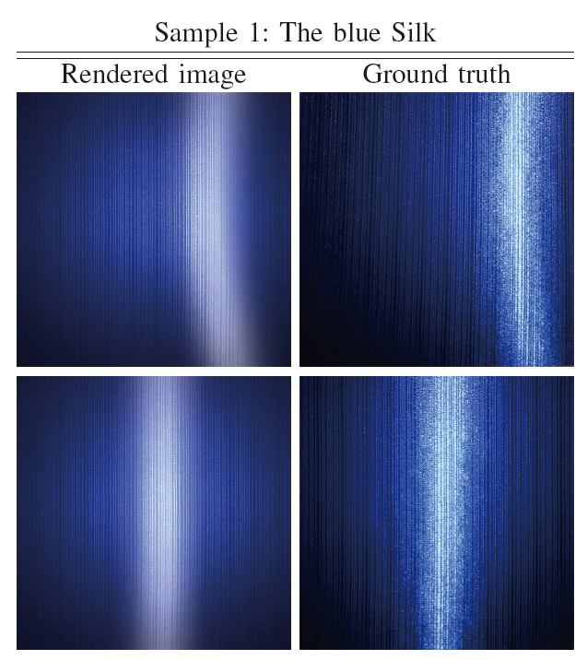

Experimental Results

Slide 25
Conclusions
An efficient anisotropic material modeling method
Requires only one image pair
No complex equipments
Quick and inexpensive material approximation
Future Work
Reconstruct a spacial-varying normal distribution
Increase the precision of the orientation field and the BRDF parameters
Extend to model inhomogeneous materials

Slide 26

Thank you!
Email: feng jie@pku.edu.cn

