Slide 1


Three-Dimensional Error-Diffusion for Importance Sampling
Ke Wang Jiaojiao Zhao Jie Feng Bingfeng Zhou
Institute of Computer Science and Technology
Peking University

Slide 2
Outline
Motivation
Related work
Three-dimensional Error-diffusion
Parameters Optimization
Experiments and Applications

Slide 3
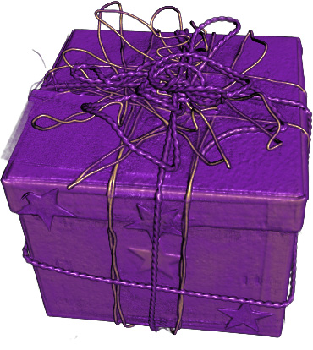
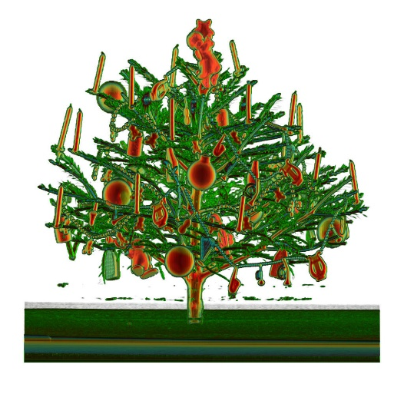
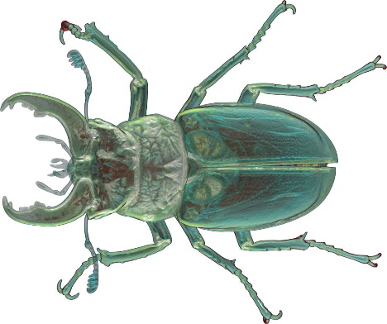
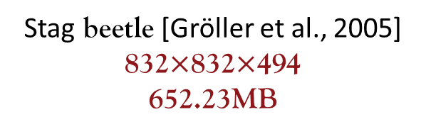
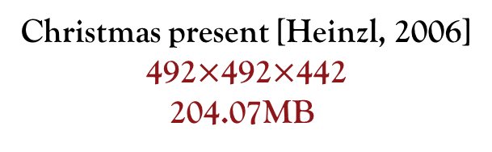
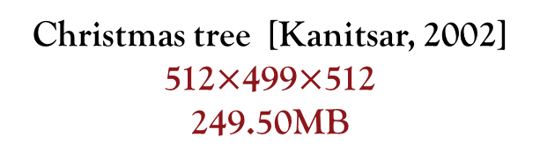
Volume dada
An industrial CT
Christmas present [Heinzl, 2006]
492$×$492$×$442
204.07MB
Christmas tree [Kanitsar, 2002]
512$×$499$×$512
249.50MB
Stag beetle [Gröller et al., 2005]
832$×$832$×$494
652.23MB
Challenge: Large
Affect the efficiency of volume rendering

Slide 4
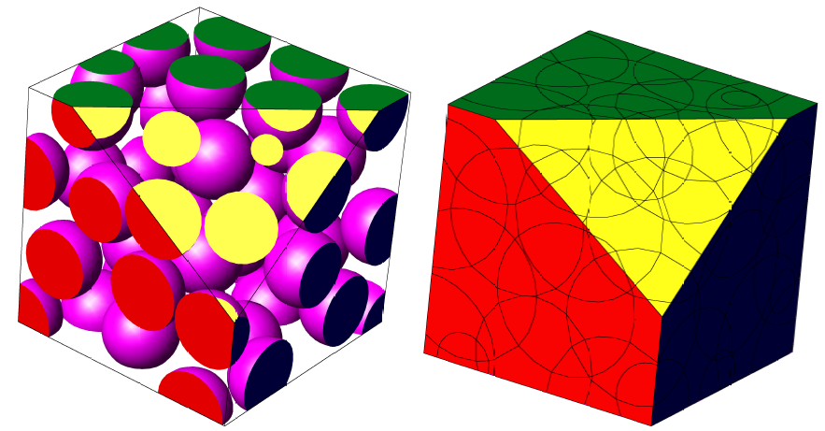
Volume Sampling
  Solution: 3D Blue noise sampling
3D Poisson disk sampling [Ebeida et al., 2012]
High cost and continuous domain
  Extending 2D error-diffusion into 3D domain
  A metric of 3D blue-noise property

Slide 5
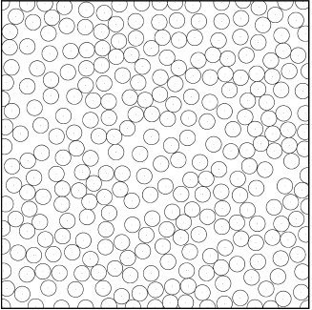
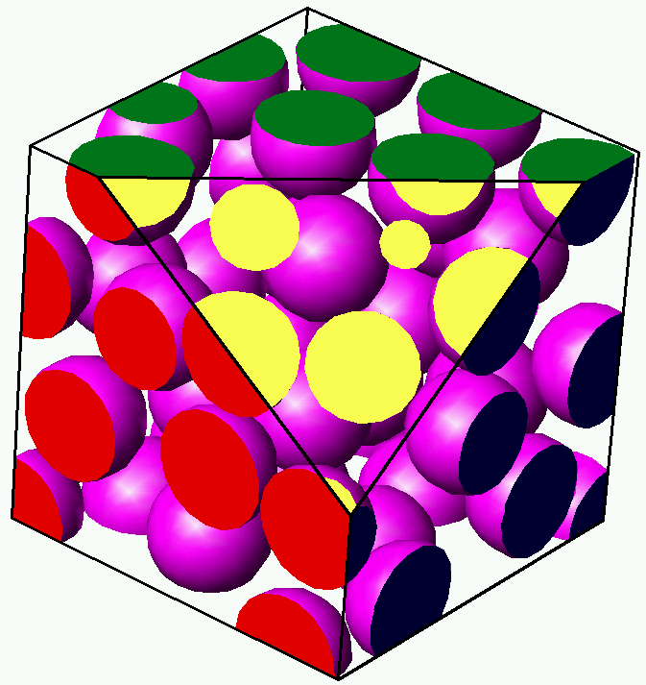
Related work
2D Poisson Disk Sampling
  Dart throwing method [Dipp´e and Wold, 1985; Cook, 1986]
  Hierarchical dart throwing [White et al., 2007]
  Two phase-algorithm [Ebeida et al., 2011]
  Multidimensional Poisson Disk Sampling
    Parallel multi-resolution uniform grid [Wei, 2008]
    Spatial subdivision [Gamito and Maddock, 2009]
    Flat quadtree method [Ebeida et al., 2012]
Their performance drops as the dimension increases

Slide 6
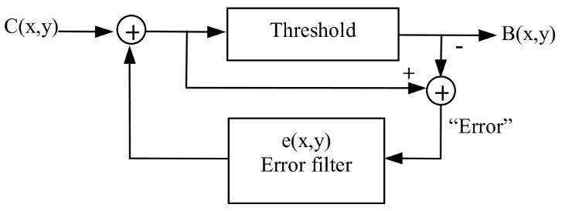
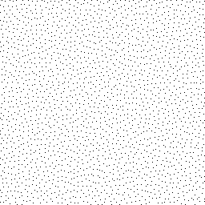
Related work
  2D Error Diffusion[Cook, 1986]
  Improvements
    The variable-coefficient [Ostromoukhov, 2001]
    The variable-threshold [Zhou and Fang, 2003]

Slide 7
Our idea
Poisson disk sampling
  Originally designed in a continuous domain
  More complicated in higher dimensions
  Error-diffusion with variable coefficients and thresholds
    High quality sampling point distribution
    Linear time complexity by using linear scanning order
  A three-dimensional error-diffusion sampling algorithm
    Based on the standard 2D error-diffusion
    Sampling points with 3D blue-noise property

Slide 8
Three-dimensional Error-diffusion

Slide 9
3D Error-diffusion
Quantization
t(g)
f(x, y, z)
+
Quantization
b(x, y, z)
−
+
+
e(x, y, z)
Error filter
  Scanning order
  Quantization threshold
  Error-filter
Diffusion

Slide 10
Scanning order
Top-bottom sequence
Rotated respectively by 90˚ for each layer
Layer-1
Layer-2
Layer-3
Layer-4
Rotated serpentine scanning order
Notes:
Every four adjacent layers from top to bottom in the input volume are grouped as one scanning cycle,
where the scanning direction of 2D serpentine scanning are rotated respectively by 90 degree for each layer.

Slide 11




Quantization threshold
$g=f\left(x,y,z\right):$density level
$$m\left(g\right)ε\left[0,1\right]$$
density-dependent modulation strength
$$t(g)=0.5+r⋅m(g)$$
quantization threshold
white-noise random number
  $$rε[0,1]$$
Variable threshold

Slide 12
Error-filter
The layer-1
+X direction
-X direction

Slide 13
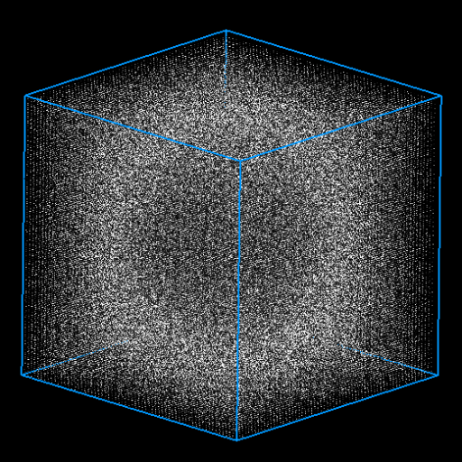
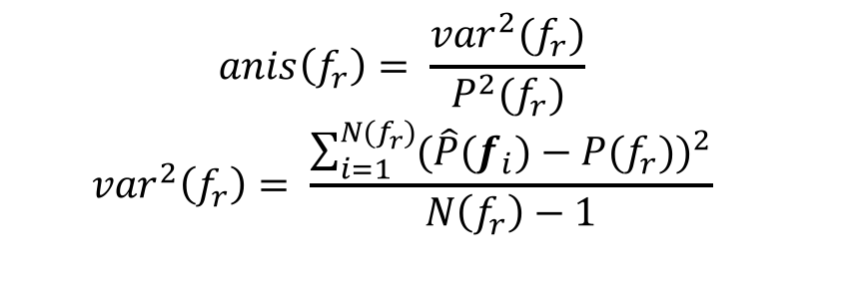
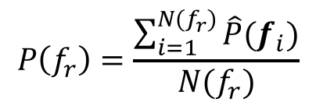
3D Blue-noise
  3D Fourier power spectrum
    Symmetrical
    Lack low frequencies
Metric
  Radially averaged power spectrum
  Anisotropy
$$P\left(f_{r}\right)=\frac{\sum_{i=1}^{N(f_{r})}{\hat{P}(f_{i})}}{N(f_{r})}$$
  $$anis\left(f_{r}\right)= \frac{{var}^{2}(f_{r})}{P^{2}(f_{r})}$$
  $${var}^{2}\left(f_{r}\right)= \frac{\sum_{i=1}^{N(f_{r})}{{(\hat{P}(f_{i})−P(f_{r}))}^{2}}}{N\left(f_{r}\right)−1}$$

Slide 14


Parameter Optimization
Search for Optimal Parameters
$$wε\left[0,1\right]$$
Target function
Constant weight
$$T\left(g\right)=w⋅L\left(g\right)+\left(1−w\right)⋅S(g)$$
Low frequency ratio
Symmetry of frequency spectrum

Slide 15
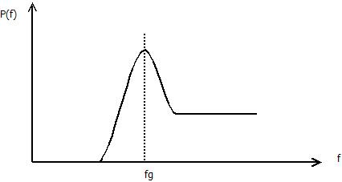
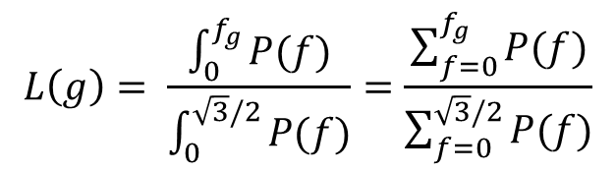
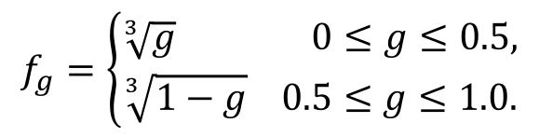
Low Frequency Ratio
Principal frequency
$$f_{g}=\left\{\begin{aligned}\sqrt[3]{g} 0≤g≤0.5, \\ \sqrt[3]{1−g} 0.5≤g≤1.0.\end{aligned}\right.$$
$$L\left(g\right)= \frac{\int_{0}^{f_{g}}{P(f)}}{\int_{0}^{\sqrt{3}/2}{P(f)}}=\frac{\sum_{f=0}^{f_{g}}{P(f)}}{\sum_{f=0}^{\sqrt{3}/2}{P(f)}}$$
Low frequency ratio

Slide 16
Symmetry of Frequency Spectrum
Considering the symmetry in one of the eight octants
Dividing the octant into three equal pyramids
three equal pyramids
eight octants

Slide 17

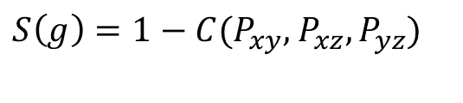

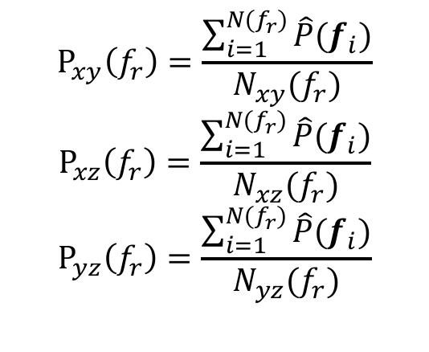

Symmetry of Frequency Spectrum
The Segmented radially averaged power spectrums(SRAPSs)
$$P_{xy}\left(f_{r}\right)=\frac{\sum_{i=1}^{N(f_{r})}{\hat{P}(f_{i})}}{N_{xy}(f_{r})}$$
$$P_{xz}\left(f_{r}\right)=\frac{\sum_{i=1}^{N(f_{r})}{\hat{P}(f_{i})}}{N_{xz}(f_{r})}$$
$$P_{yz}\left(f_{r}\right)=\frac{\sum_{i=1}^{N(f_{r})}{\hat{P}(f_{i})}}{N_{yz}(f_{r})}$$
$$P_{yz}\left(f_{r}\right)$$
$$P_{xz}\left(f_{r}\right)$$
$$P_{xy}\left(f_{r}\right)$$
The similarity function
$S\left(g\right)=1−C(P_{xy},$ $P_{xz},P_{yz})$
Correlation function (Gonzalez et al.,2004)

Slide 18
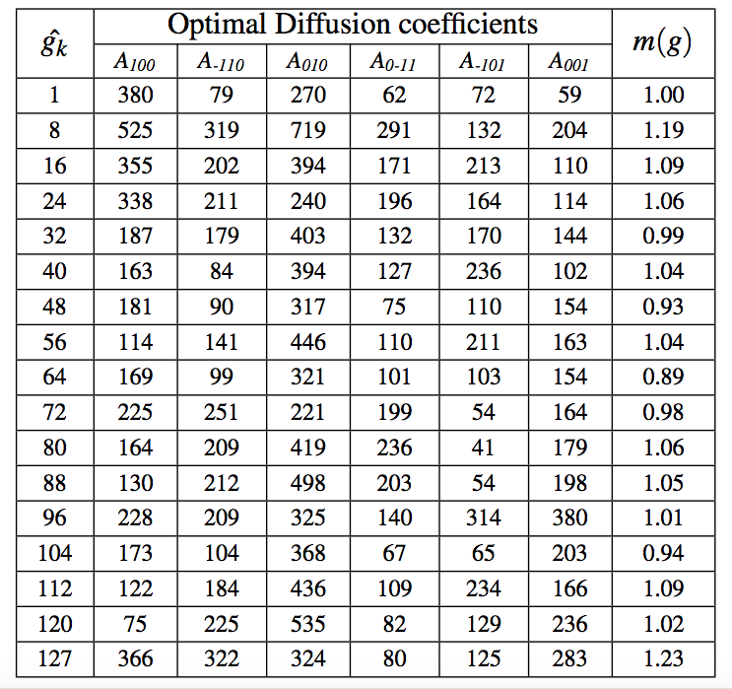
Parameter Optimization
A simplex optimization algorithm [Press et al. 1992]
Key density levels: optimization
Other density levels: a linear interpolation
Optimal error-diffusion parameters

Slide 19
Experiments and Applications

Slide 20
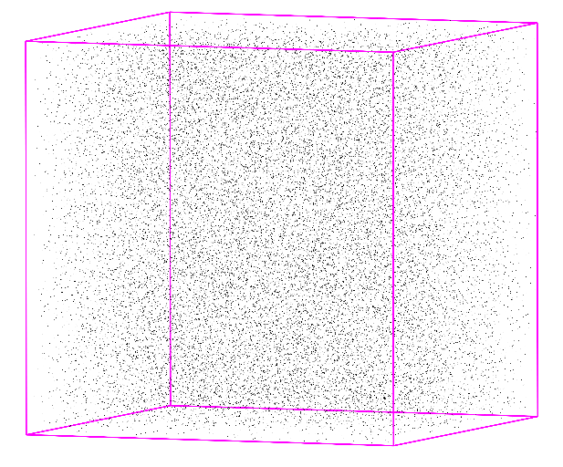
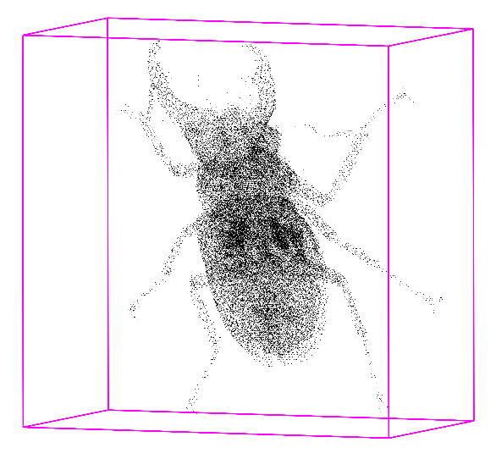
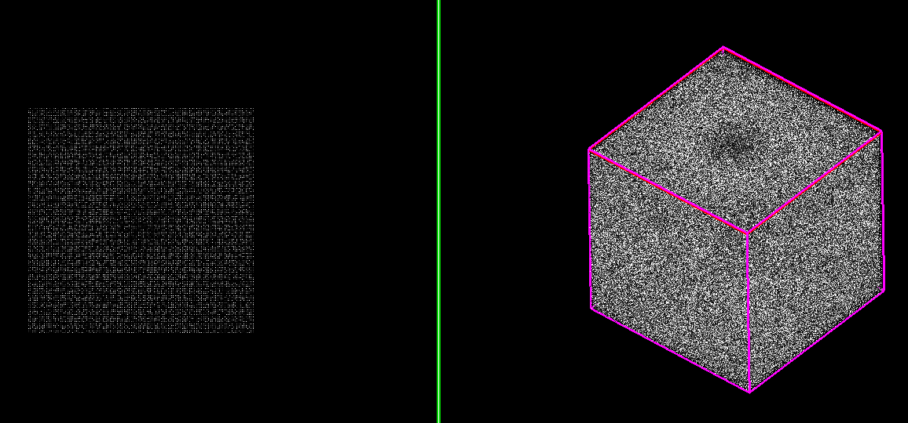
Experiments
3D error-diffusion sampling on discrete volume data
Fixed-density
Variable-density
Fourier power spectrum

Slide 21
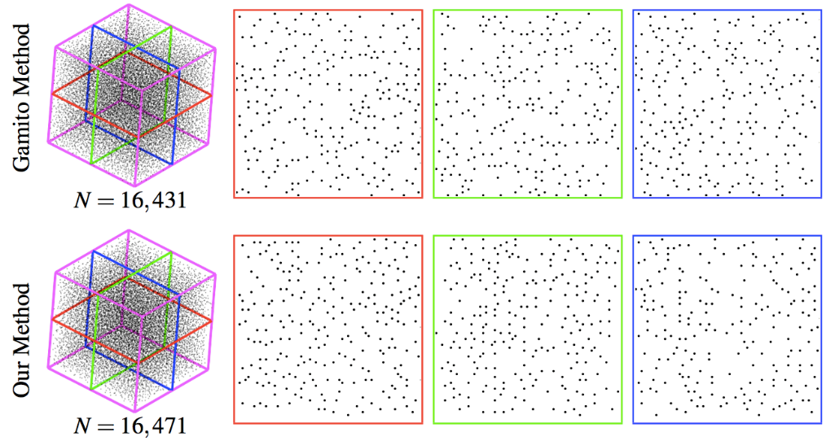
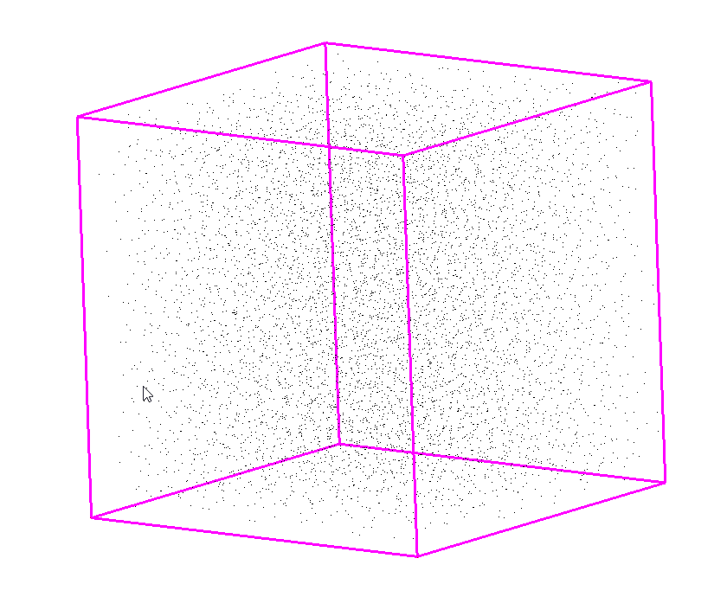
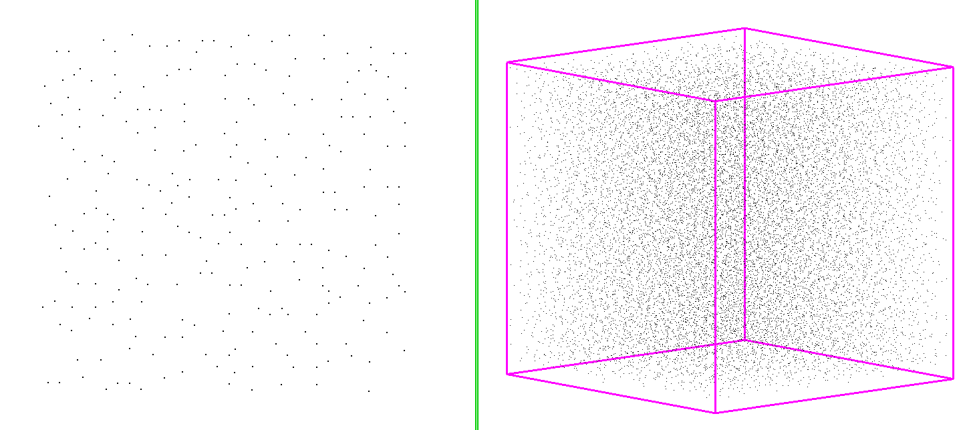
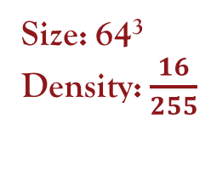
Experiments
Size: 64³
Density: $\frac{16}{255}$
Comparison with Poisson Disk Sampling
Sampling slices

Slide 22
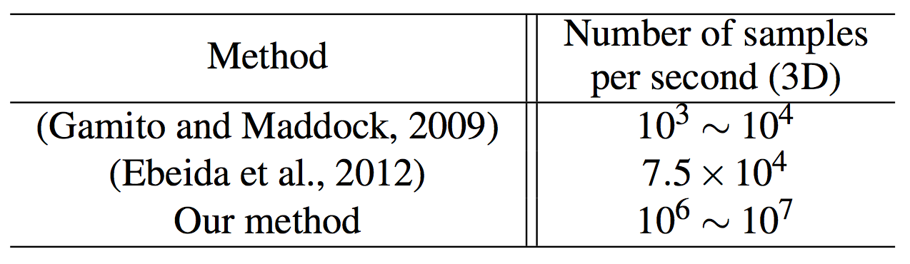
Experiments
Comparison with Poisson Disk Sampling
Hardware
  An Intel i7 3.4GHz CPU (Our method)
  A dual AMD Athlon MP2600 2.1 GHz [Gamito and Maddock, 2009]
  NVIDIA GTX 460 [Ebeida et al., 2012]
Average sampling efficiency

Slide 23
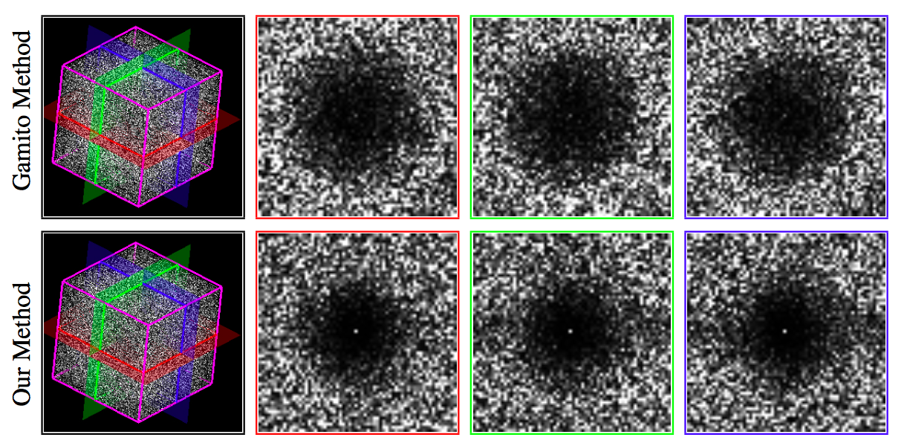
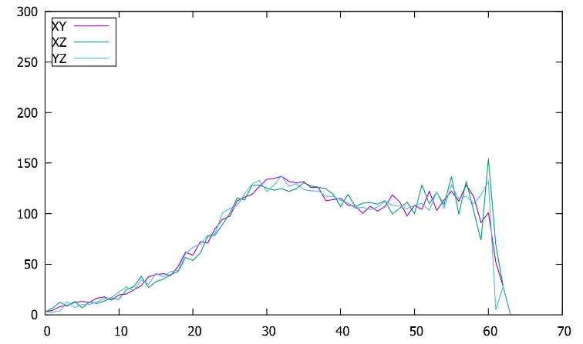
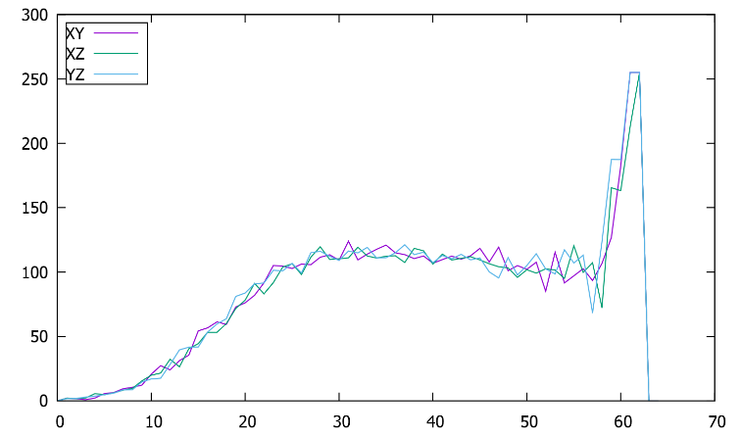
Experiments
Spectrum slices
Gamito method (3D Poisson Disk)
Our method
SRAPSs

Slide 24
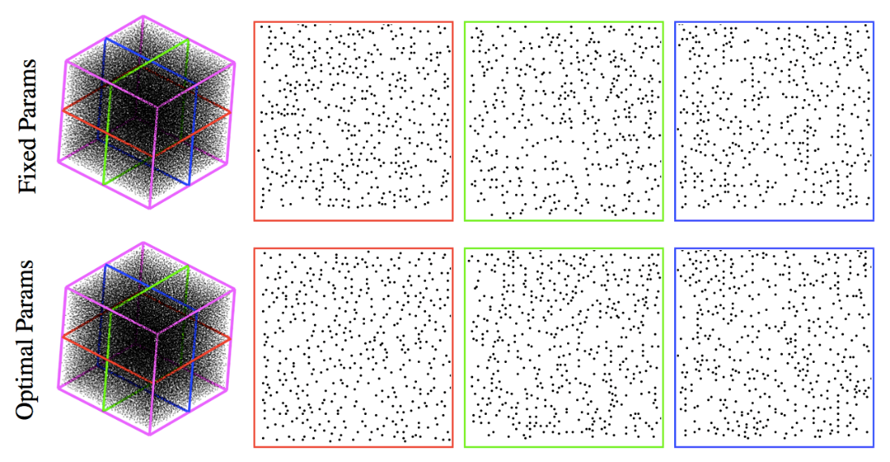
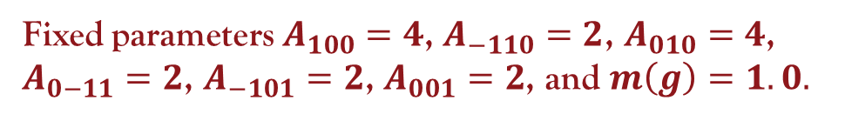
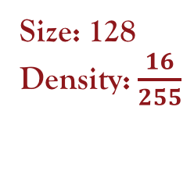
Experiments
Size: 128
Density: $\frac{16}{255}$
Volume Data with Fixed Sampling Density
Fixed parameters $A_{100}=4$, $A_{−110}=2$, $A_{010}=4$, $A_{0−11}=2$, $A_{−101}=2$, $A_{001}=2$, and $m\left(g\right)=1.0.$
Sampling slices

Slide 25
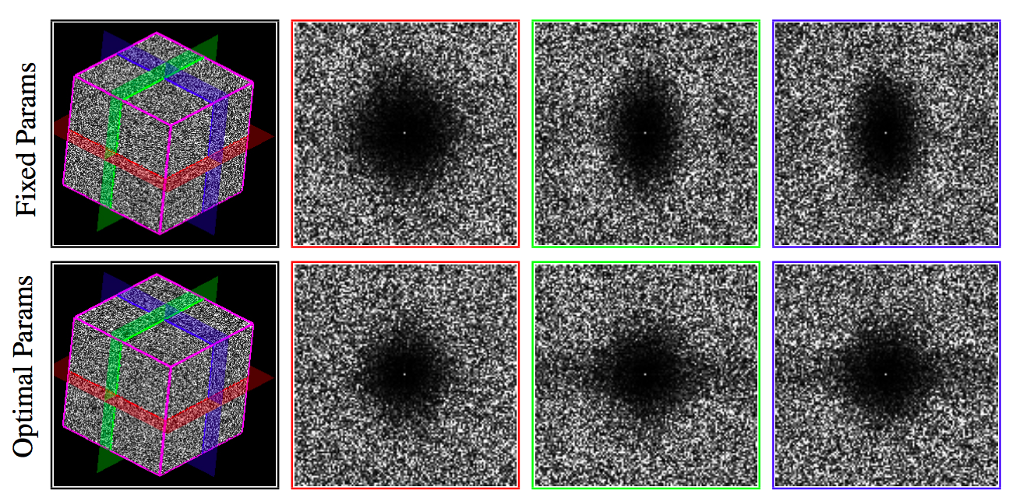
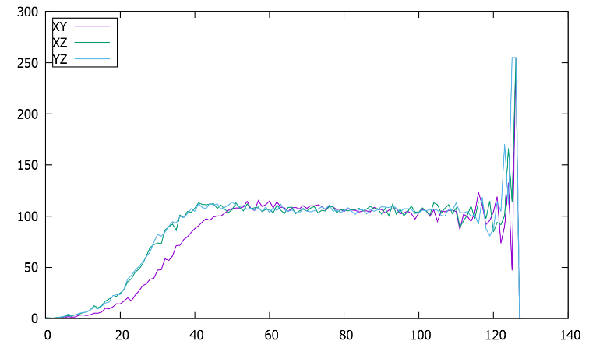
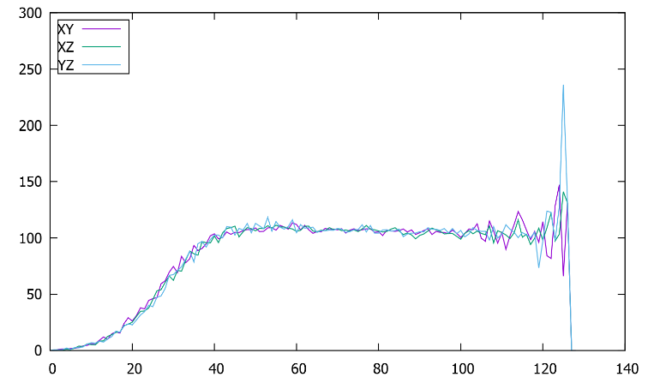
Experiments
Spectrum slices
Fixed parameters
Optimal parameters
SRAPSs

Slide 26
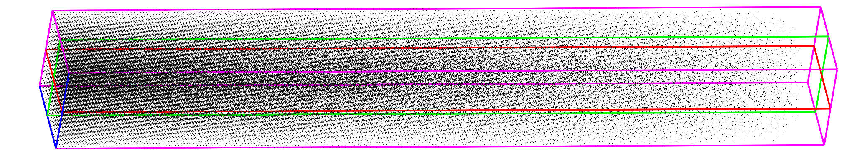
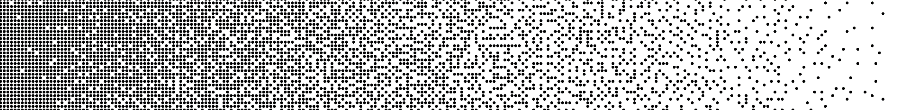
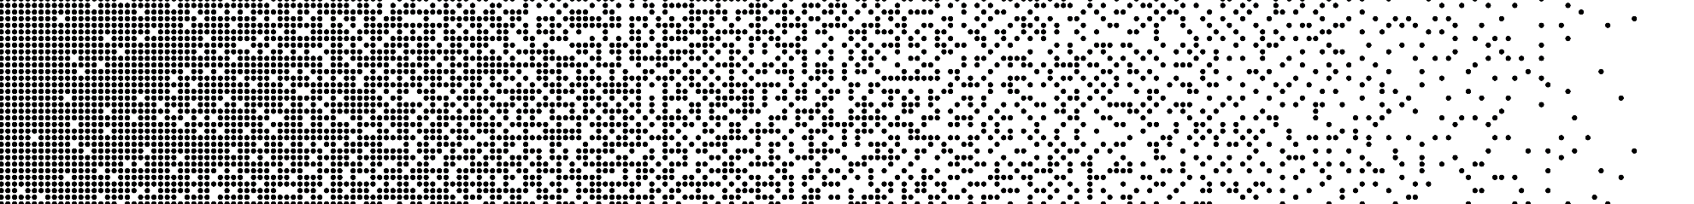
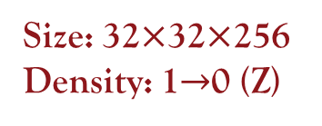
Experiments
Size: 32$×$32$×$256
Density: 1$→$0 (Z)
Volume Data with Variable Sampling Density
XZ-Slice
YZ-Slice

Slide 27
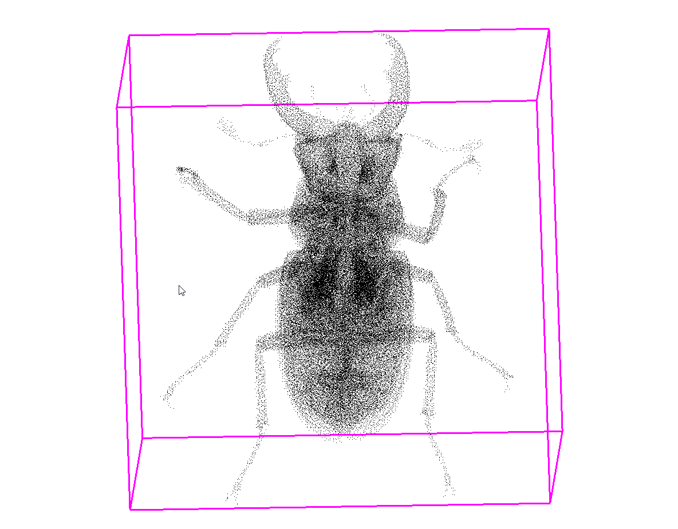
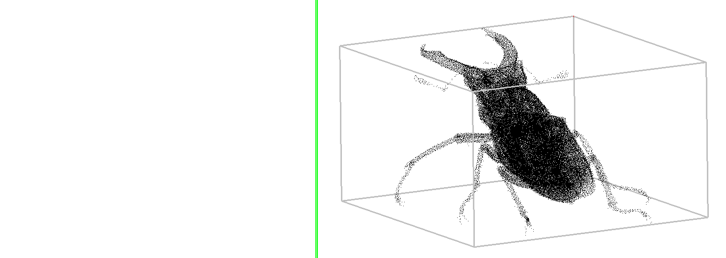
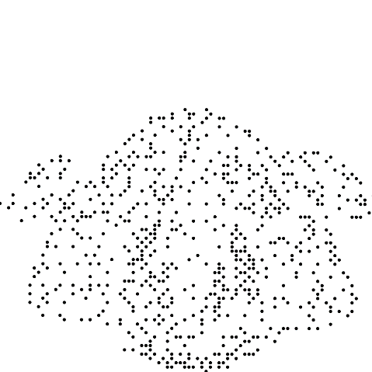
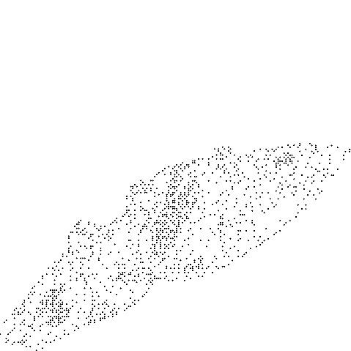
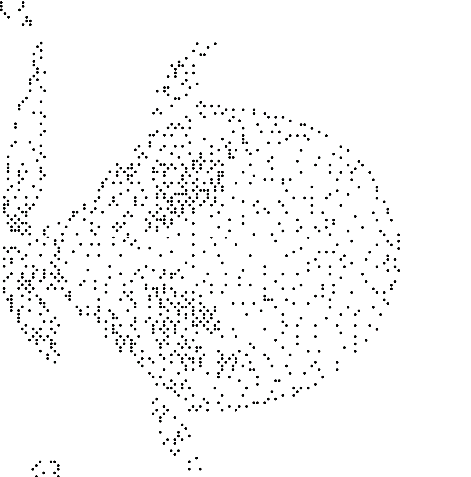
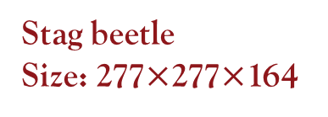
Experiments
Volume Data with Variable Sampling Density
Stag beetle
Size: 277$×$277$×$164
XY-Slice
XZ-Slice
YZ-Slice

Slide 28
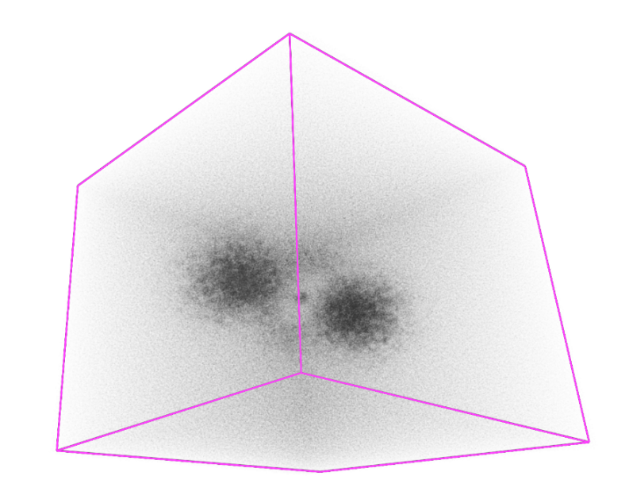
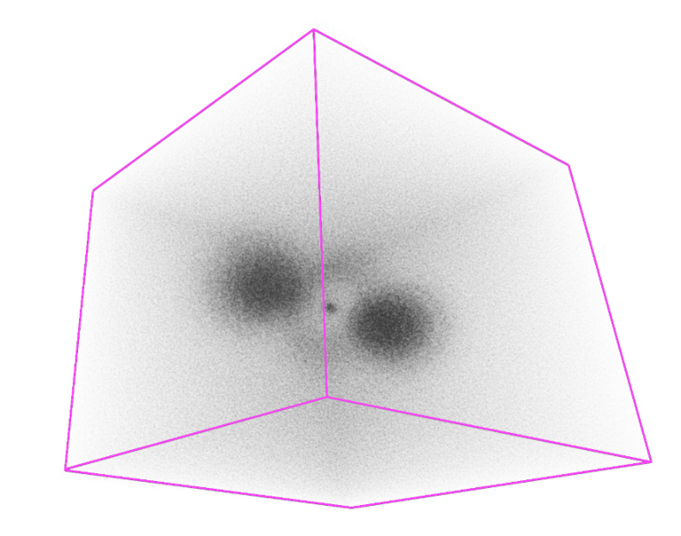
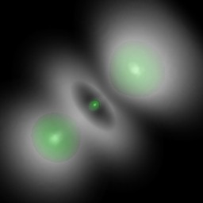
Application – Volume Rendering
  Particle-based volume rendering [Sakamoto et al. 2007]
  Improve the distribution of particles
Hit-and-miss method
Our 3DED method
Ground truth
Hydrogen Atom (http://lgdv.cs.fau.de/External/vollib/)
Notes:
Simulation of the spatial probability distribution of the electron in a hydrogen atom, residing in a strong magnetic field.
PBVR takes tiny particles as render primitives. The particles are generated from a given 3D scalar field based on a user-specified transfer function. Then, the final rendering results is calculated by projecting these particles onto the image plane.

Slide 29







Application – Volume Tetrahedral Meshing
Fixed-density volume data
Size: 64³
Density: $\frac{80}{255}$
Variable-density volume data
Hydrogen Atom
Size: 128³
Notes:
We also implement a volume tetrahedral meshing method on the basis of our 3D error-diffusion sampling method.
The tetrahedral meshing is performed based on the sampling points generated by our 3D error-diffusion method, and completed using the tools of TetGen.
From the sliced views of the tetrahedral meshes, we can see that the internal sampling points of the volume data are evenly distributed,
hence the resulting meshes have a regular tetrahedral structure.

Slide 30
Conclusion & Future Work
Conclusion
  The main frame of 3D error-diffusion
  An effective metric of 3D blue-noise property
  Optimal error diffusion parameters
  Application in various areas
Future Work
  Volume rendering
  Volume data compression

Slide 31
Thank you~

